Slide 1
DESIGN OF A MIXED REAILTY SYSTEM FOR ARCHEOLOGY
Akshat Singh
2019A7PS0074P

Slide 2
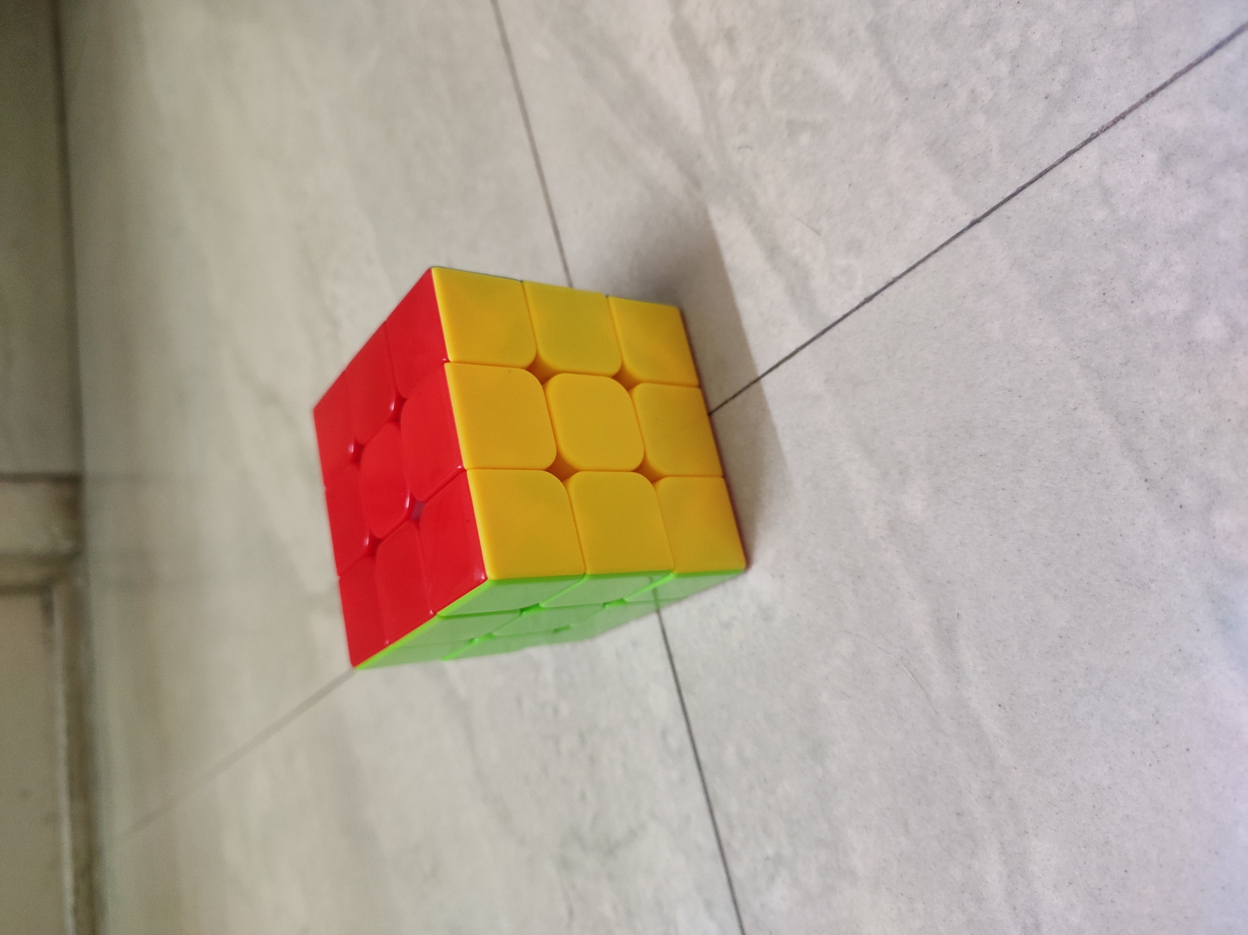
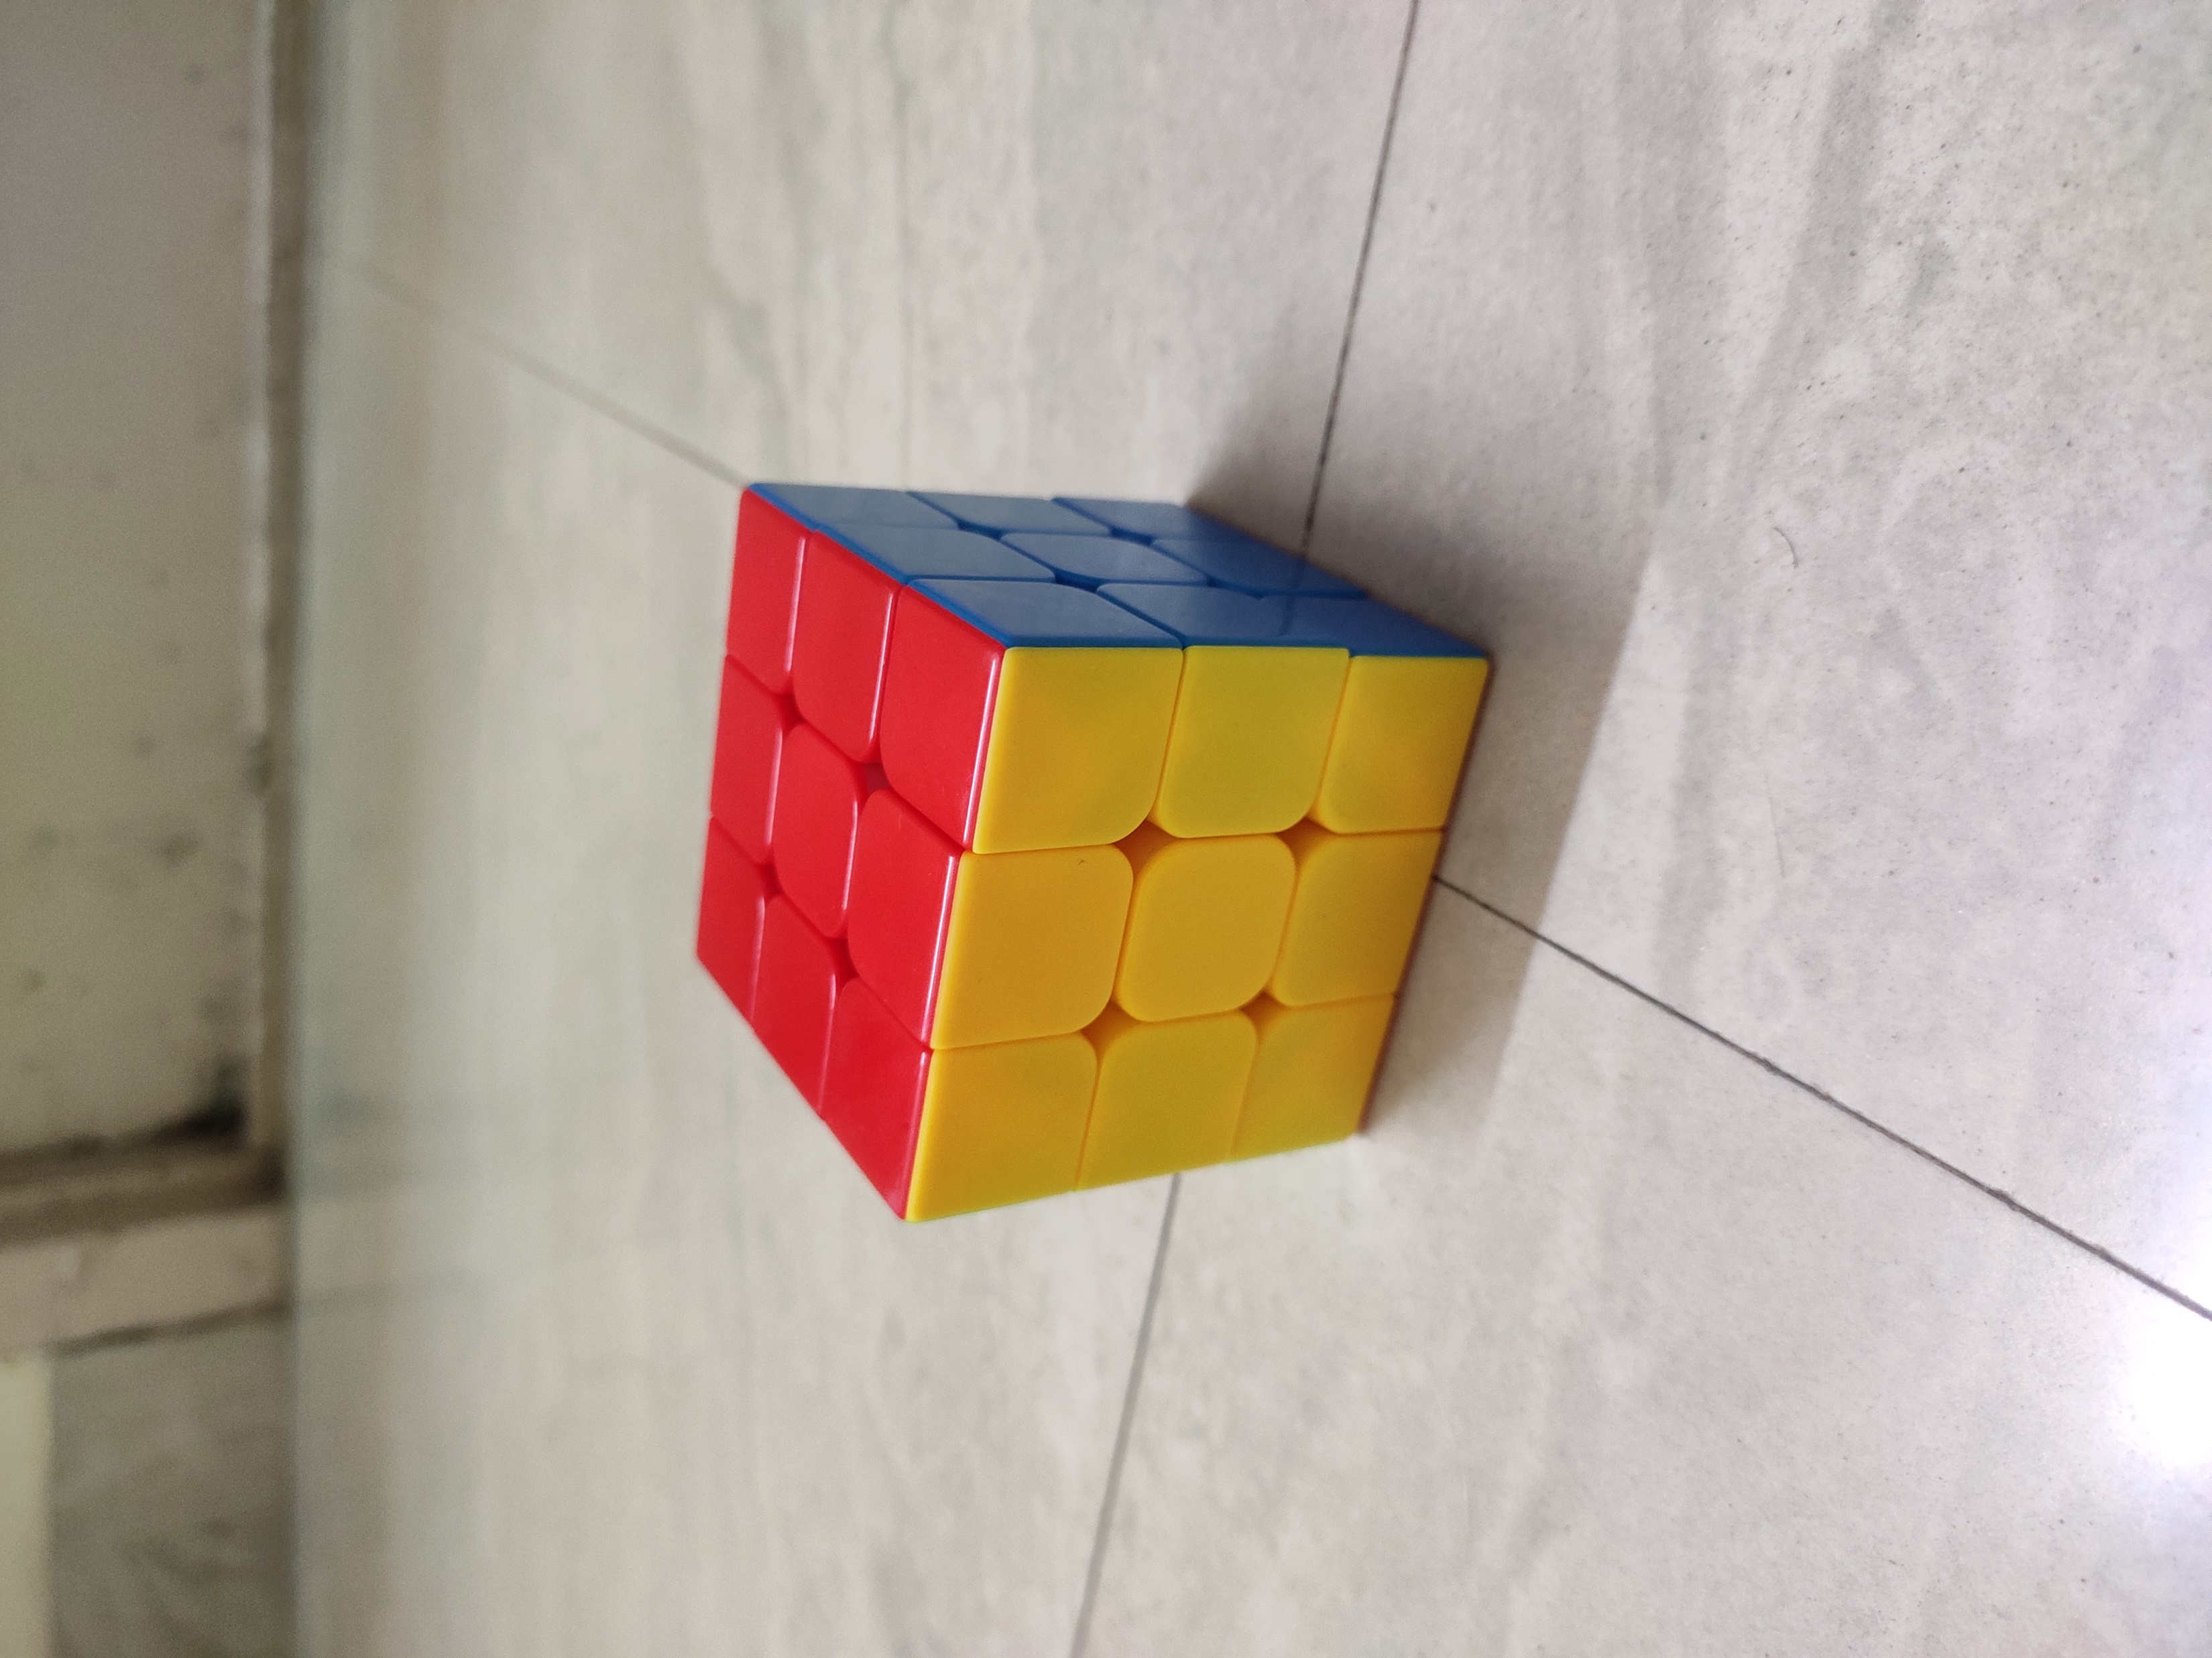
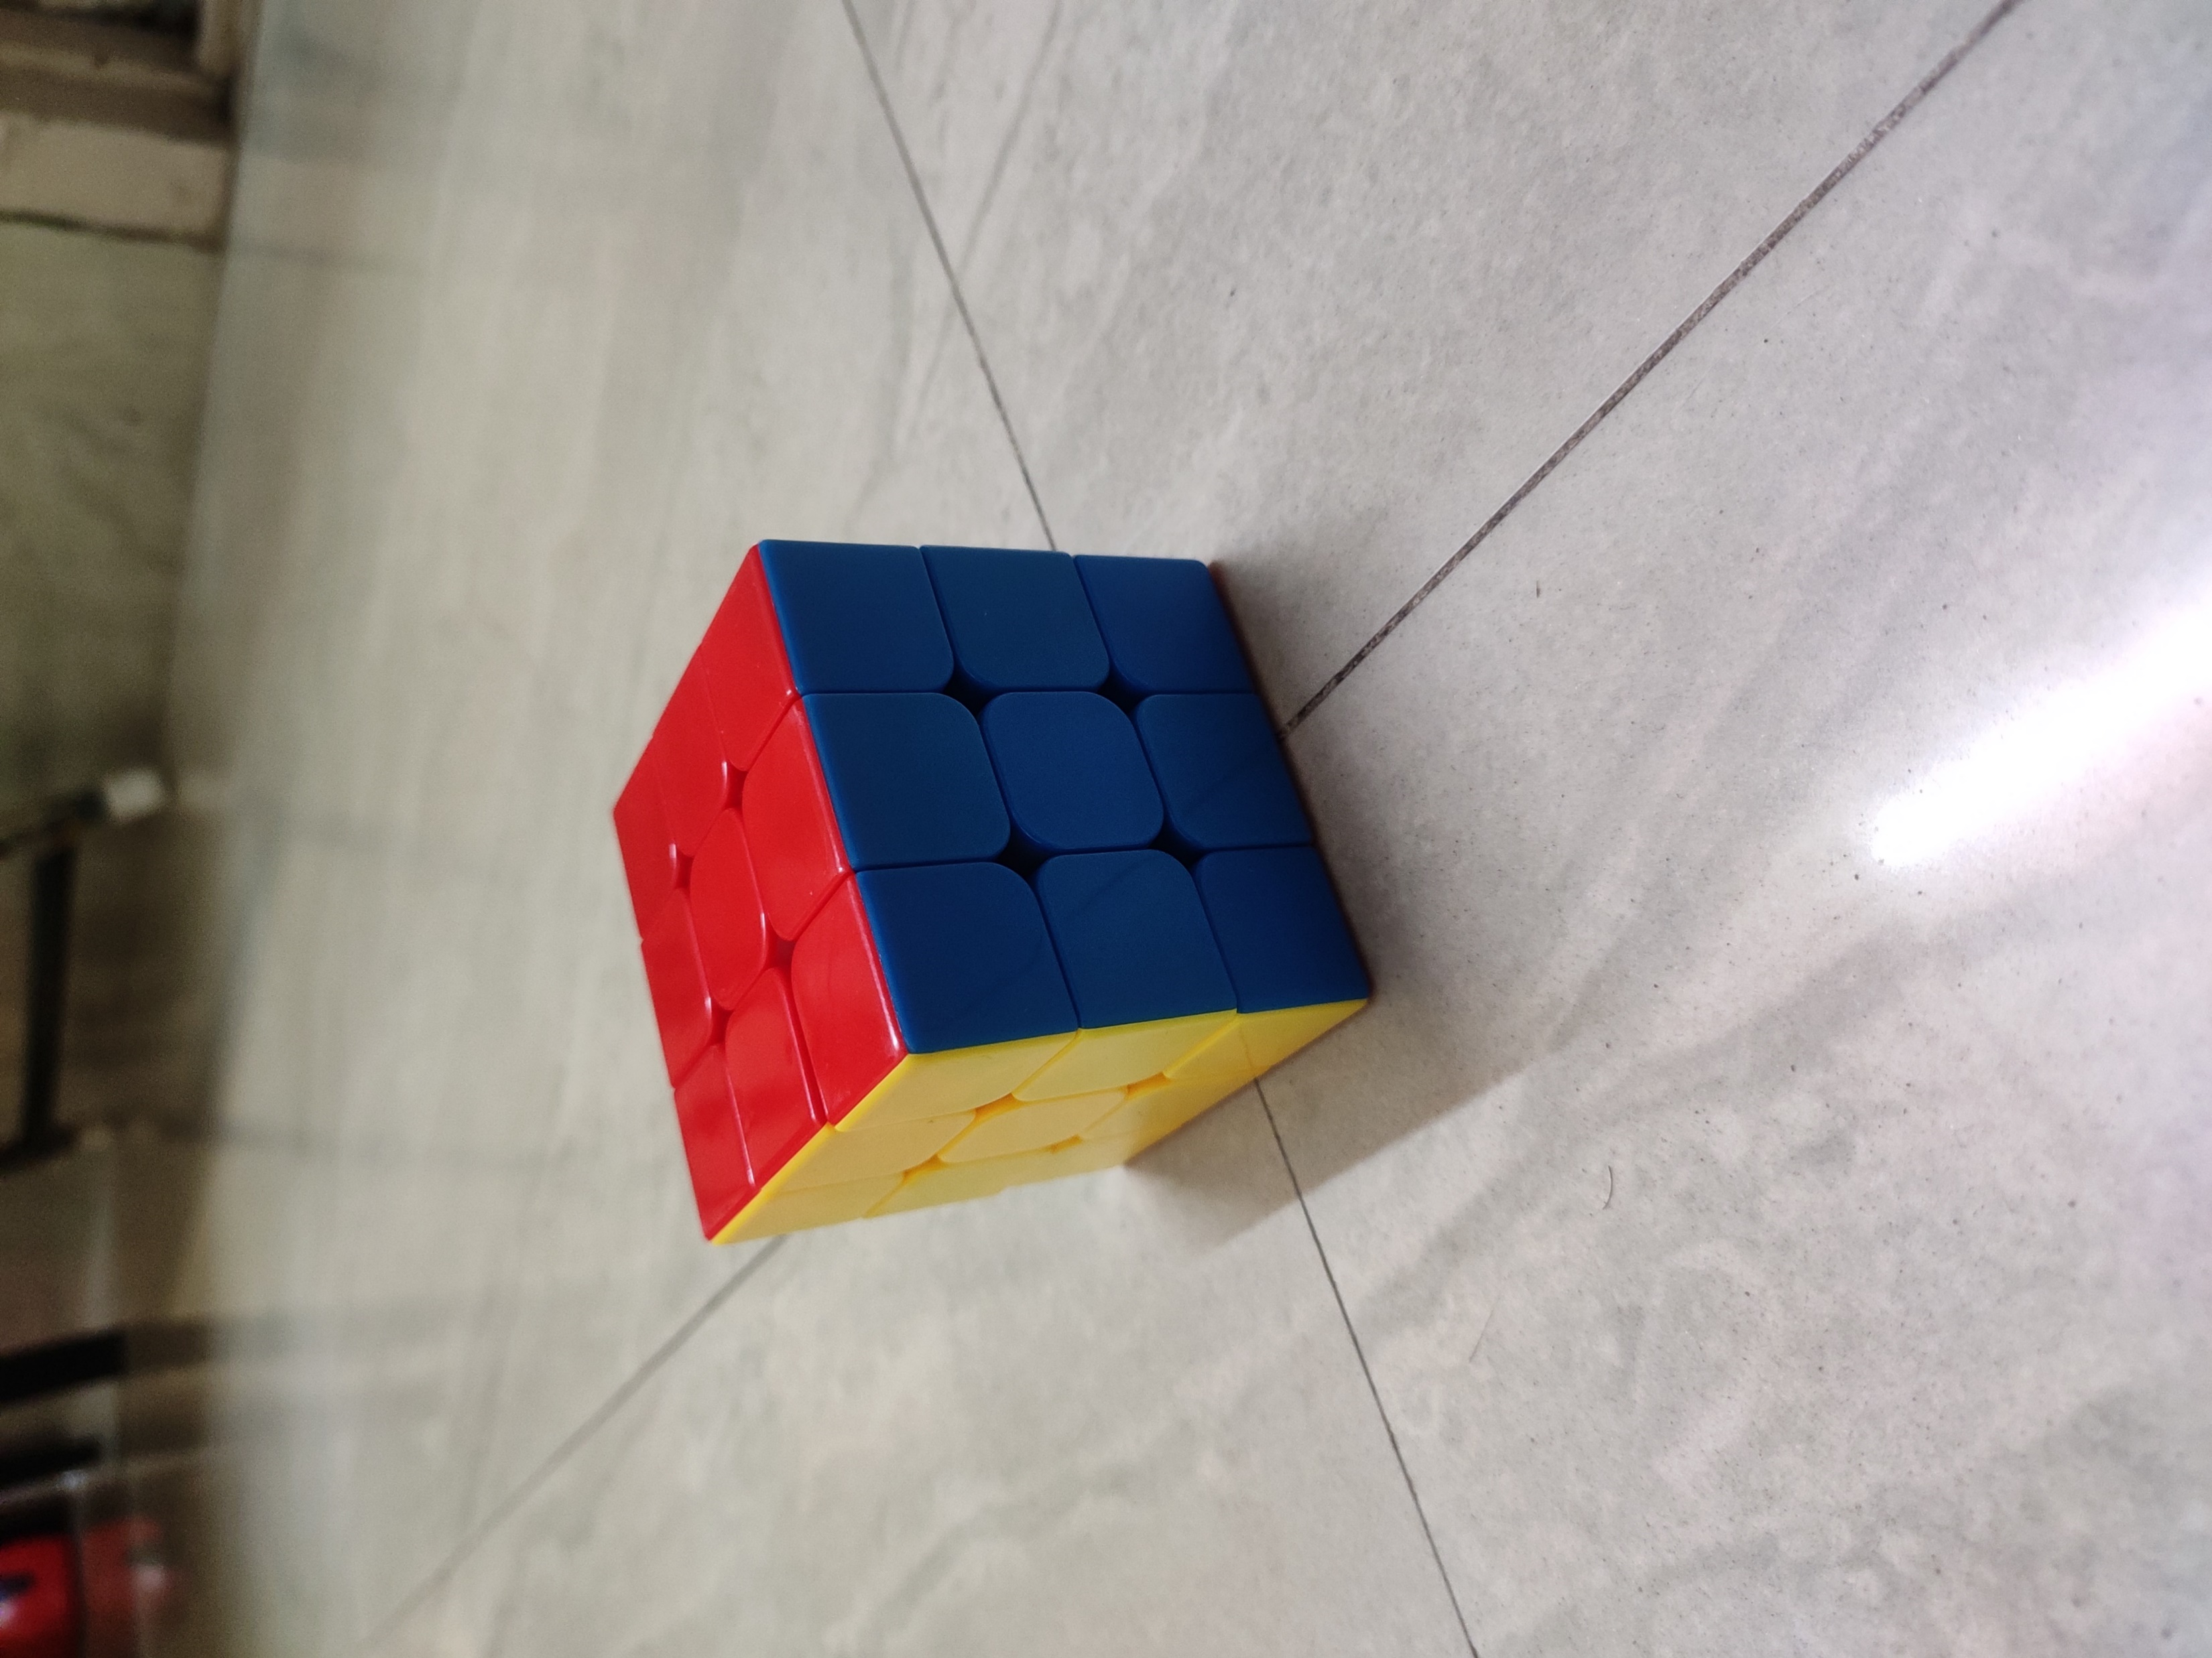
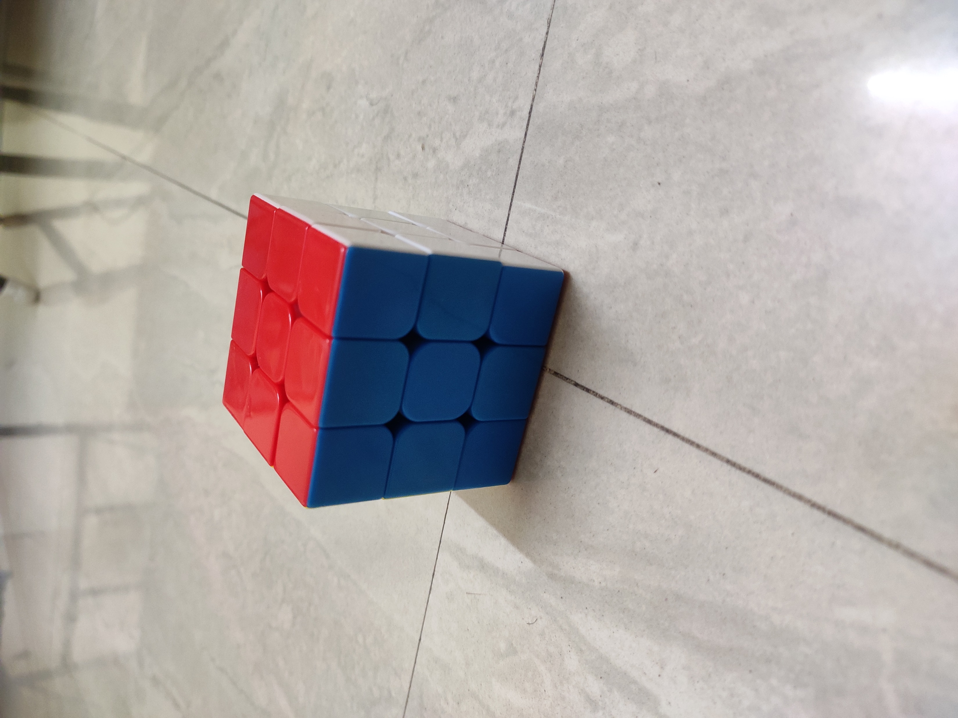
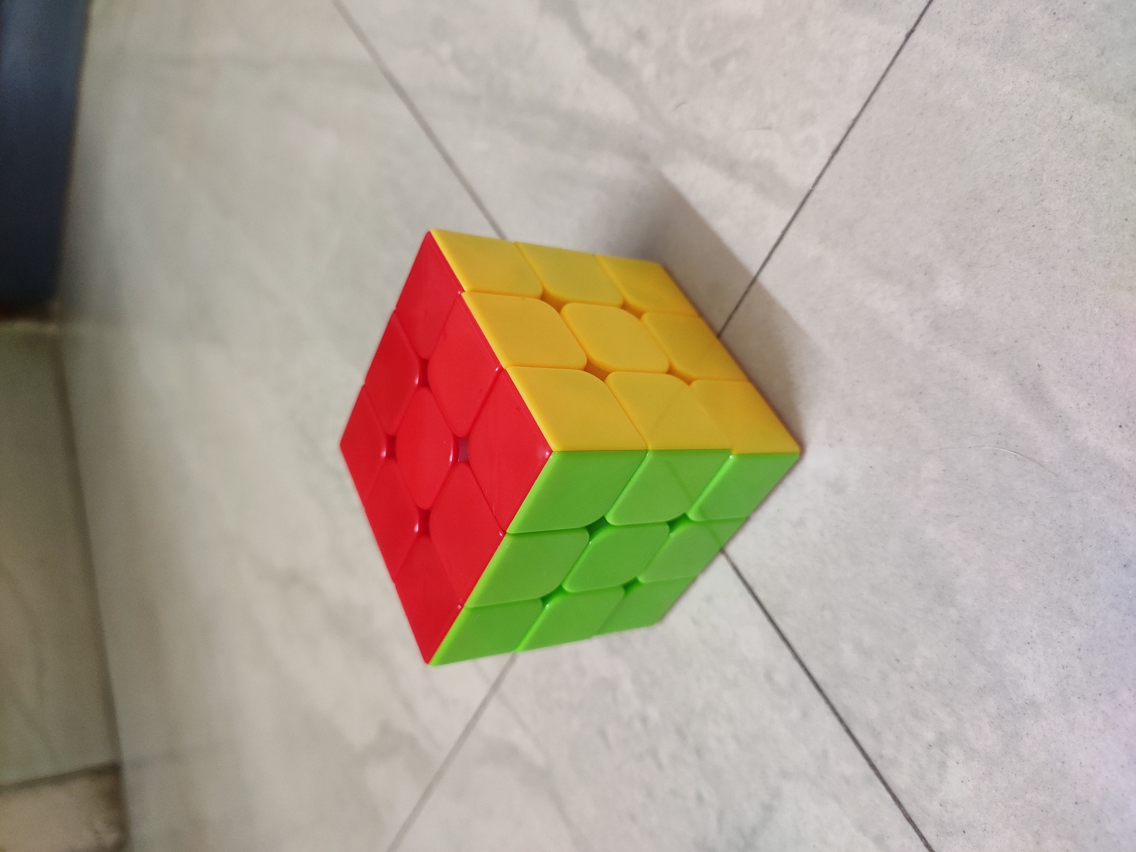
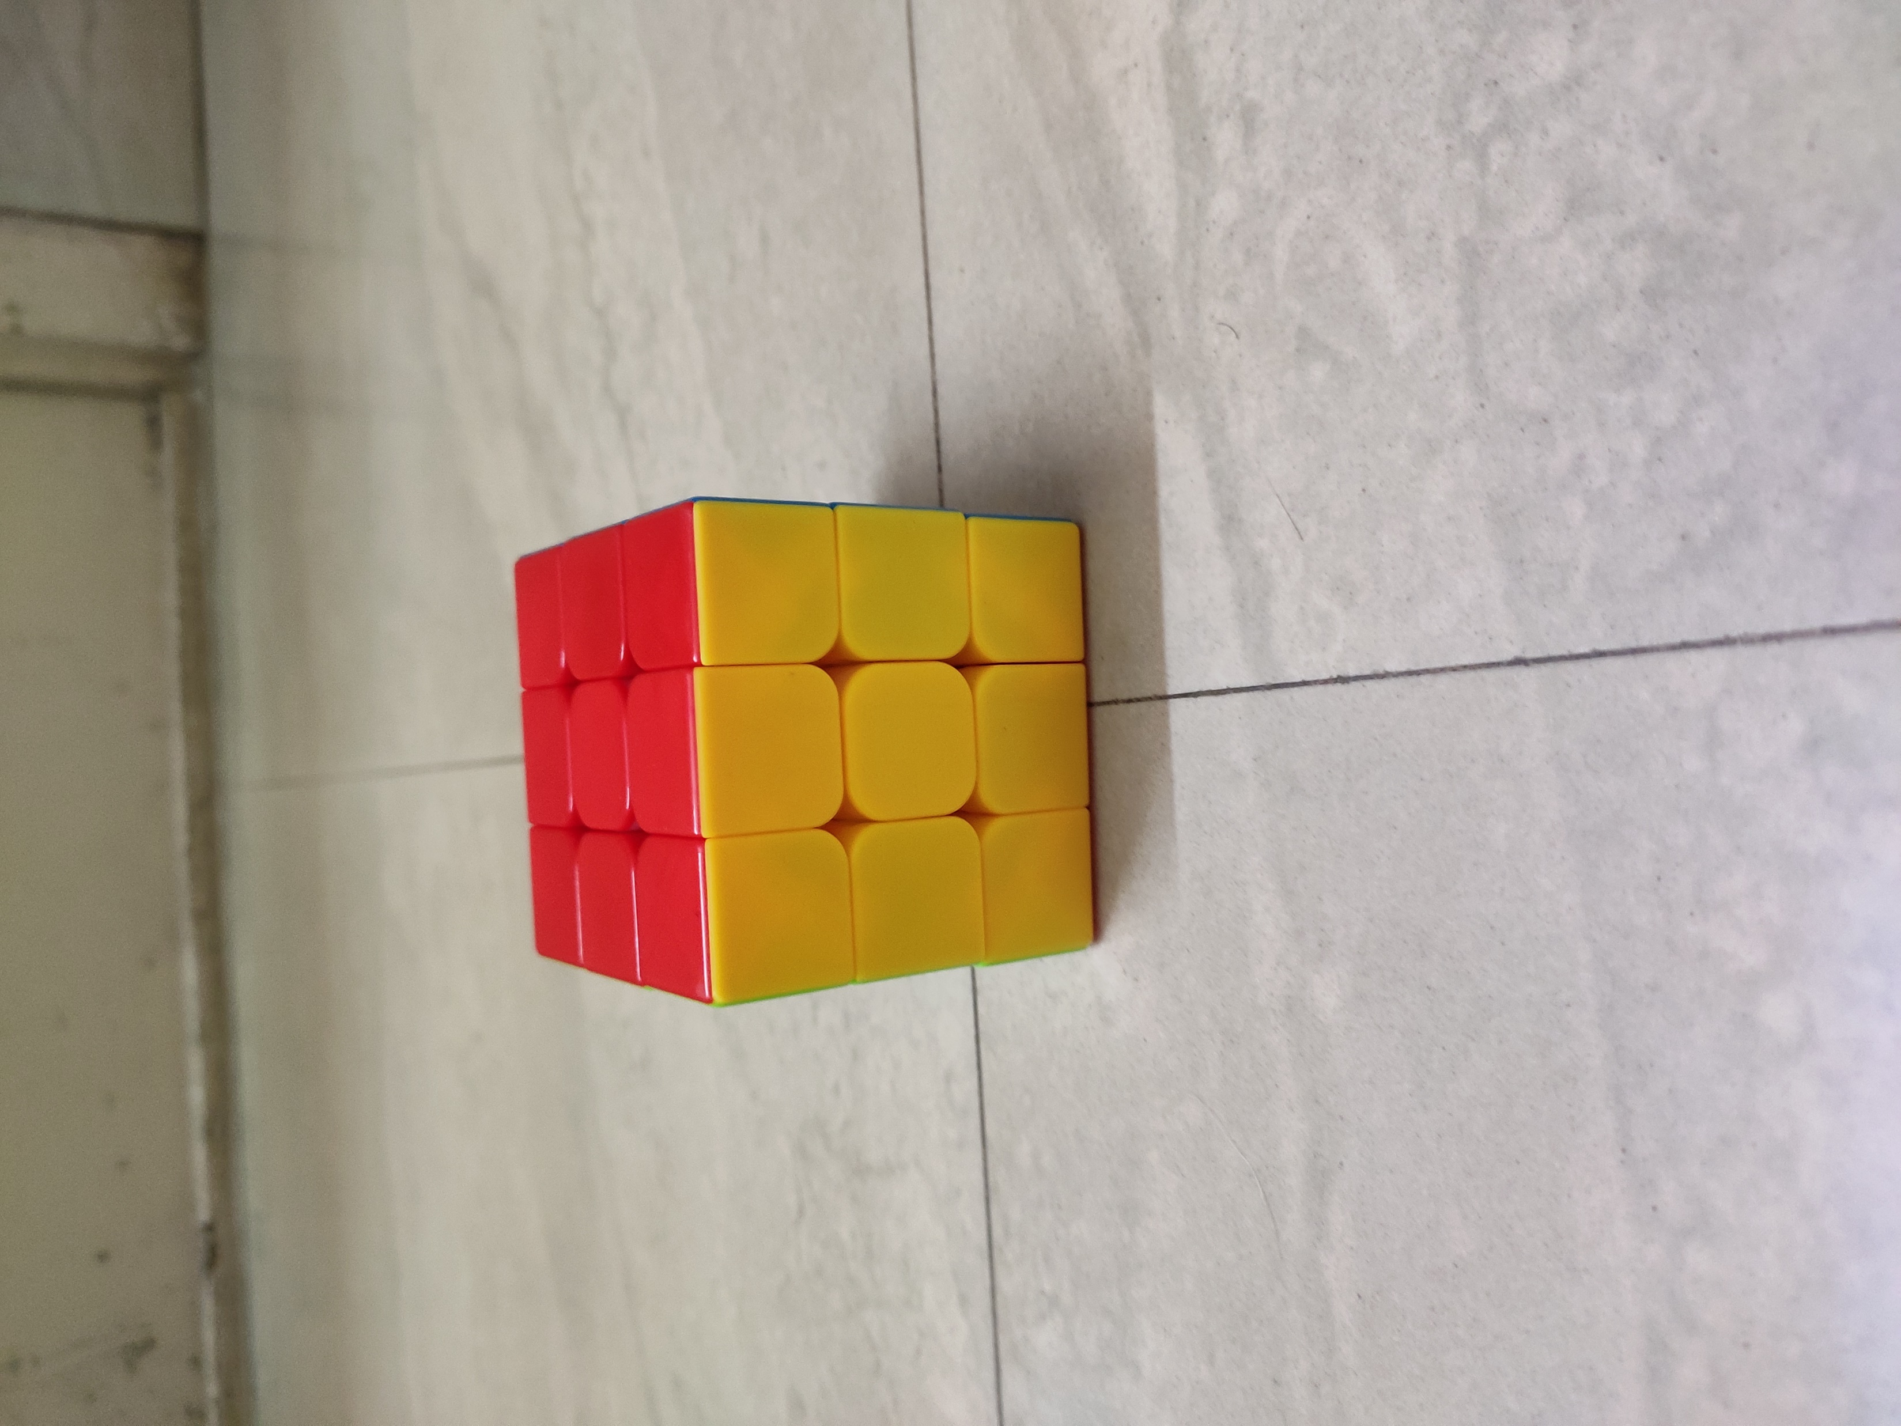
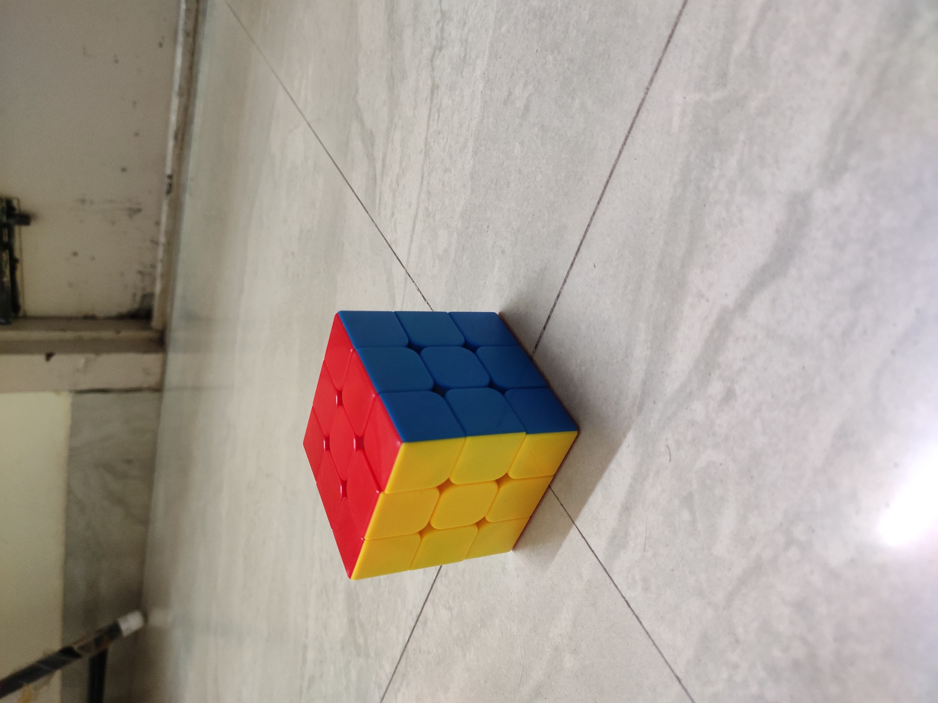
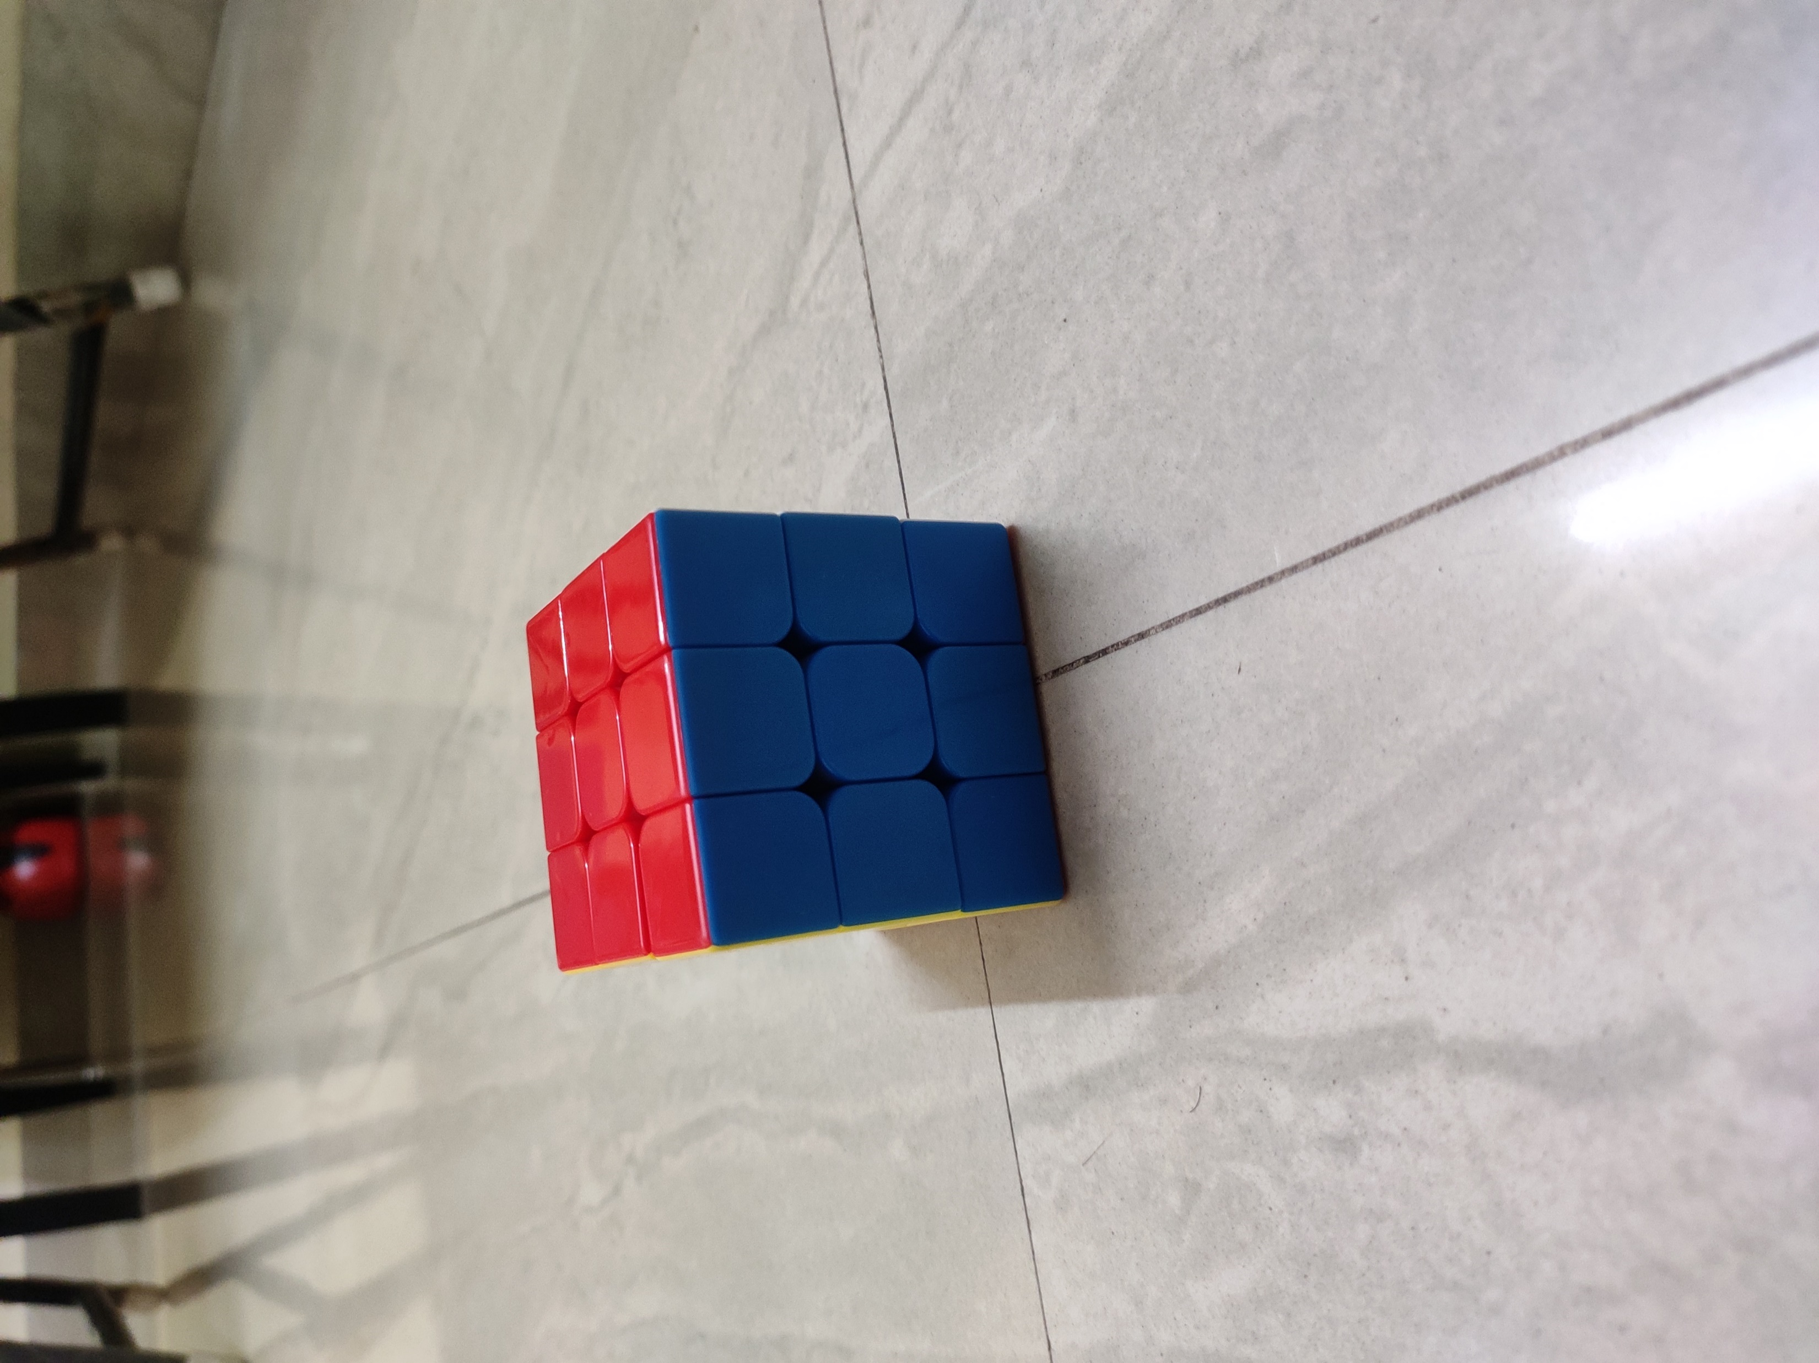
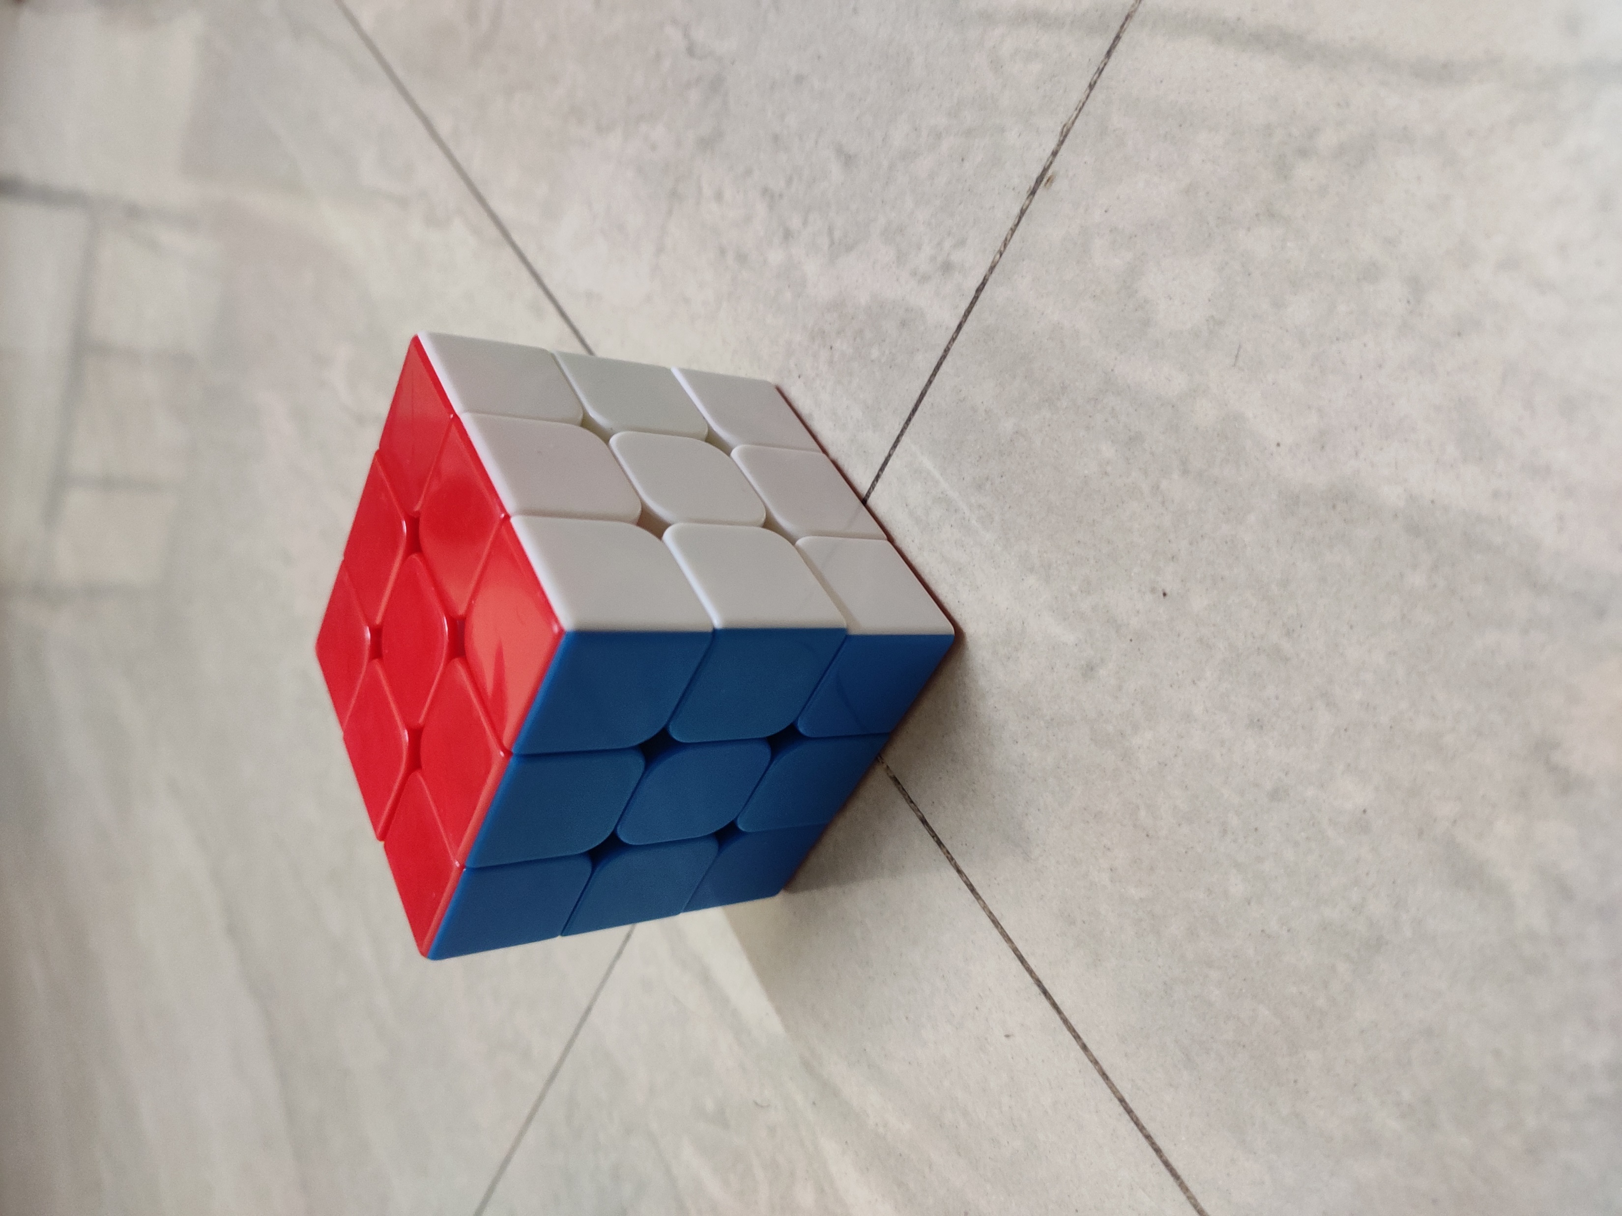
3D Modeling
We must prepare to make a 3D model of any given object. The initial trial was done for a Rubik’s Cube. Softwares used for the process were Meshroom, Blender and Unity.
First step involves taking pictures of the object from all different sides and angles.

Slide 3
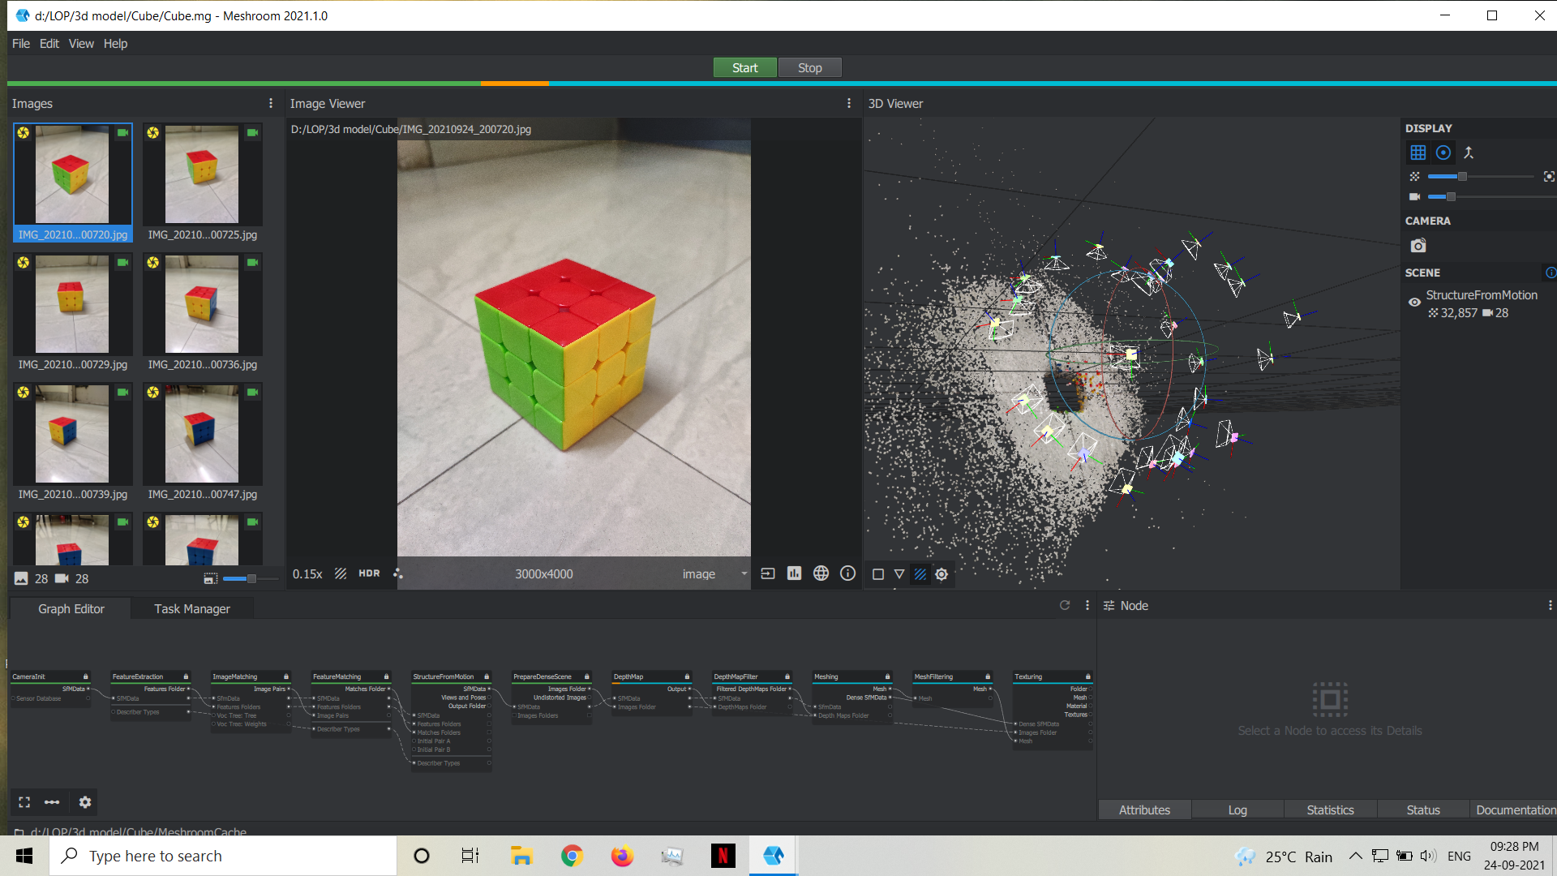
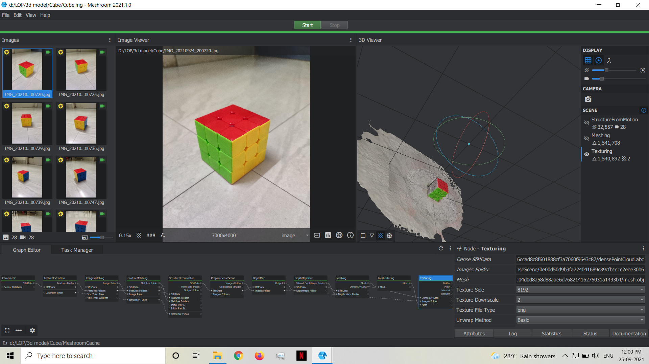
Working in Meshroom
Secondly, we need to process these images in Meshroom. It creates a mesh of pixels which acts as a base for the actual texture.

Slide 4
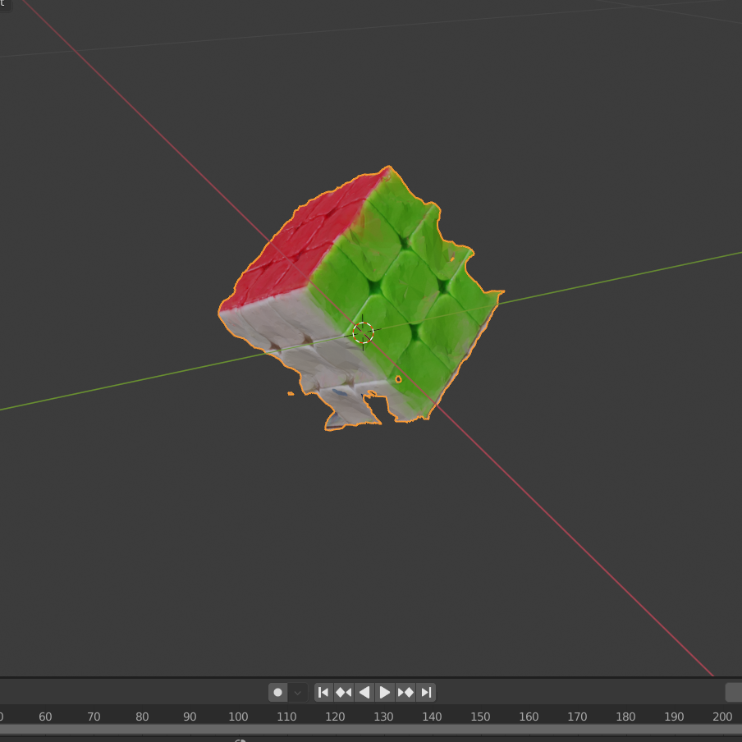
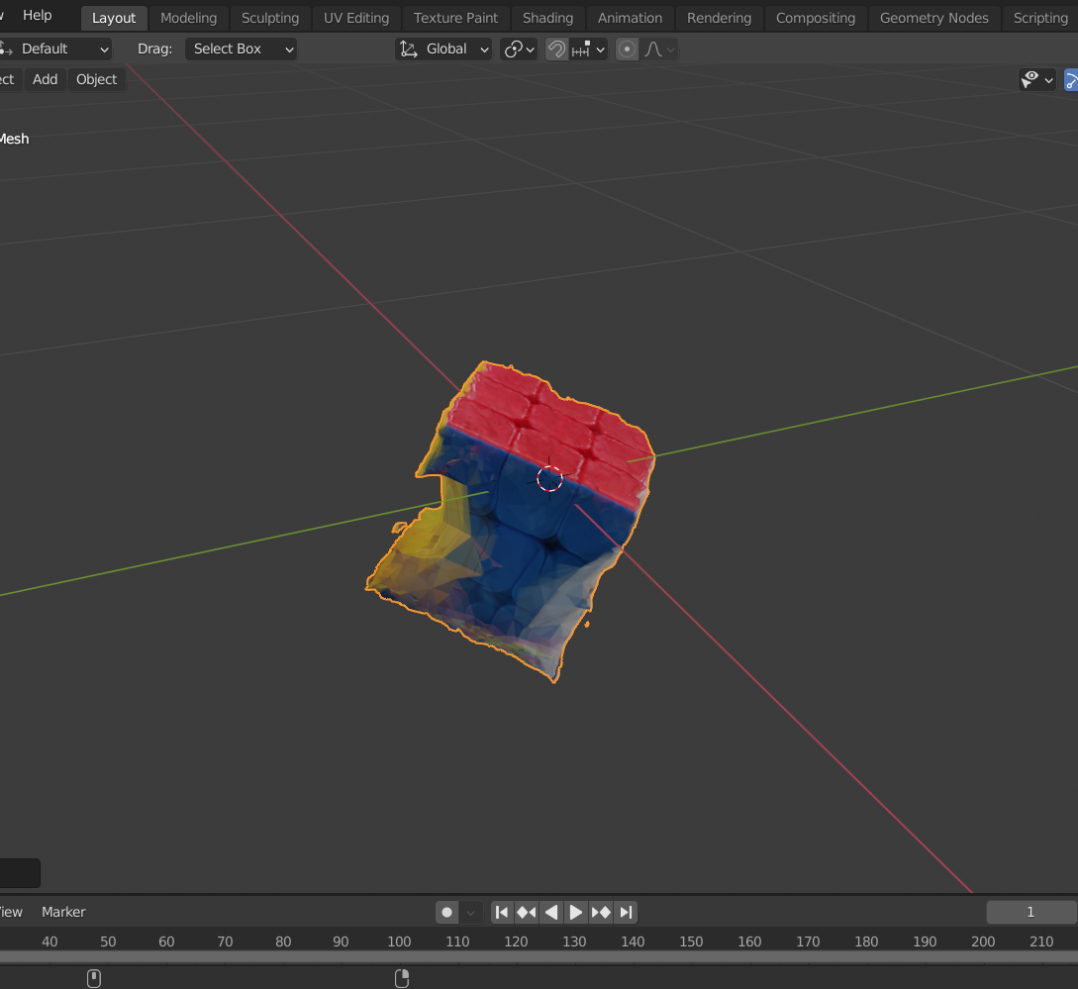
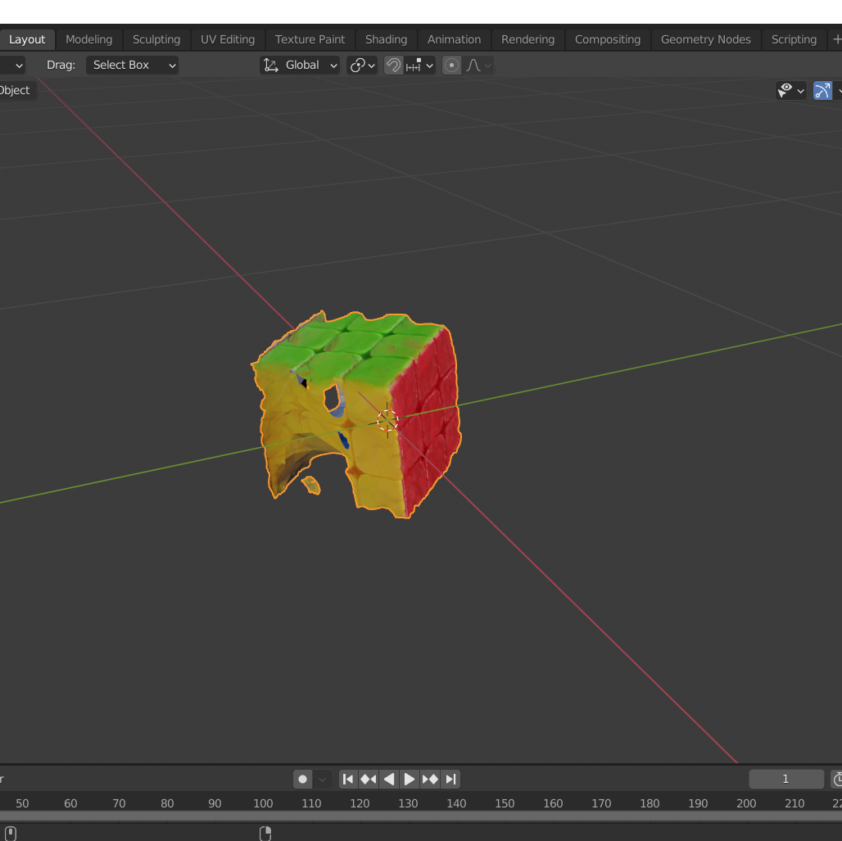
Texturing in Blender
This file from meshroom can be exported to Blender to be worked upon.
There are some irregularities visible in these 3D recreations. These are due to lighting and shadow issues. Surround lighting and clearer pictures will solve this problem and give a perfect result.
These models can then directly be used in Unity applications.

Slide 5
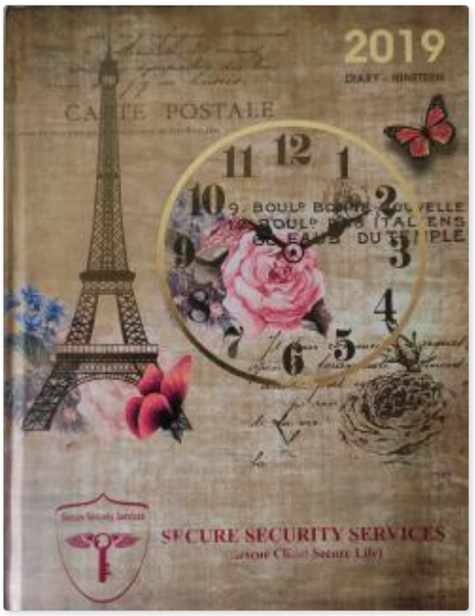
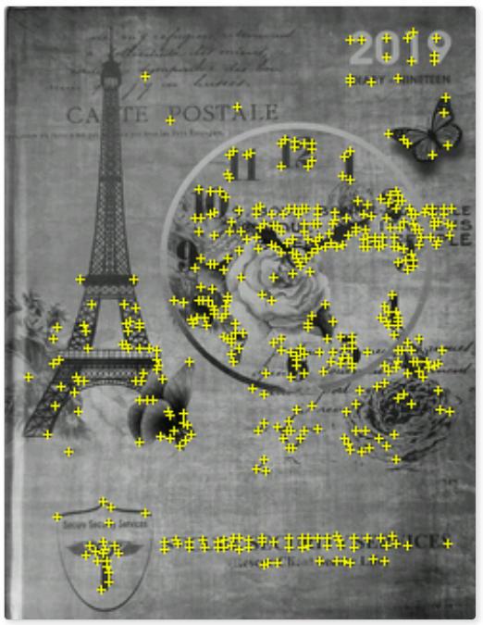
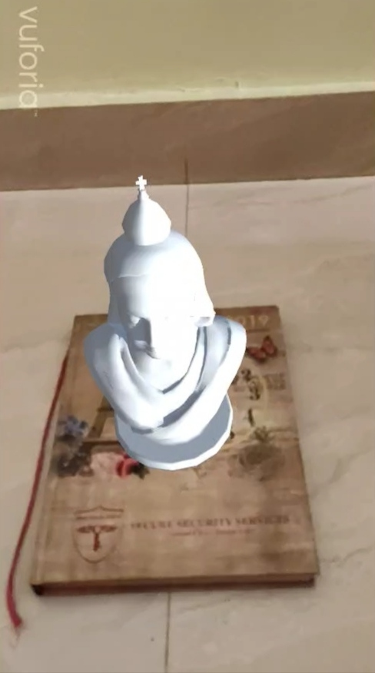
AR App
Unity along with Vuphoria Can be used to generate required application.
For e.g. detecting a target and placing 3D model on it can be the base of development.
→
This bust is a free Unity asset. The app detects the target and places the model on top of it.

Slide 6
Workplan
This is a very general and trial approach.
Need to customize based on our requirements.
For e.g. in place of diary as our target we can have the degraded structure/artifact, and in place of bust model we can have our 3d construction of that structure/artifact.
So it might look like a complete reconstruction of the structure.
Model precision has to be improved. Clearer and sharper pictures with proper lighting will give better results.

